Slide 1
Get Better Fast: Mixture Analysis
Reverse Searching and NNLS

Slide 2
Main Process Steps: Overview
1. Baseline Correction
2. Smoothing
3. Normalize spectrum with its max intensity
4. Peak detection with CWT
5. Query matches database majors peak → calculate match quality
6. Use NNLS on spectra with a certain MQ or better to estimate ratios
7. Standardize spectra

Slide 3
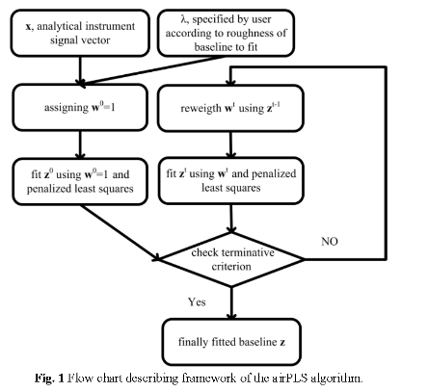
Baseline Correction

Slide 4
Baseline Correction II
In the past, common methods have been simple/modified polynomial fitting, penalized least squares (PLS) or weighted LS, wavelet using morphological erosion, derivatives, and robust local regression
PLS: Iteration weights are based on the sum squares errors (SSE) between the original signal and the last fitted baseline
New method of airPLS used to reduce Raman peak influence gradually

Slide 5
Old Method Drawbacks
Simple polynomial fit: Not very effective, accuracy highly dependent on skill of user
Modified polynomial fit: Poor performance in low signal-to-noise and signal-to-background ratio environments
Penalized least squares: Peak detection reliant and can produce negative amplitudes for complex signals

Slide 6
Old Method Drawbacks II
Wavelet: Baseline must be well-separated in the transformed signal domain (good in theory, worse in practice)
Derivatives: Change original peak shapes
Robust local regression: Baseline must be smooth and not too varying, also needs user input for bandwidth and tuning parameters
baselineWavelet package: poor sparse matrix and linear algebra supporting libraries in R limits signal size to 5k variables

Slide 7

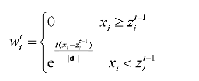

airPLS
Adaptive iteratively reweighted PLS is a procedure that gradually arrives at a baseline over several adjustments
Speedy, accurate, and flexible
Weight vector w:
Initialize w=1, each iterative w afterwards should be defined by:

Slide 8

airPLS II
Continue reweighting w to fit z and performing more iterations until either the selected number of iterations has been performed, or stopping criterion has been reached:
Algorithm has a linear runtime due to using sparse matrix linear algebra techniques, ensuring good performance for large number of variables

Slide 9


Smoothing
Fidelity: How close data sets are to each other. In this case, how similar is a fitted data set to the original? Measured by the SSE between them:
Roughness: How much does a data set change from point to point? Measured by sum of the squared differences:

Slide 10

Smoothing II
Use a Whittaker smoother similar to the one outlined by “A Perfect Smoother” (Eilers 2003) based on penalized least squares
I is the identity matrix, D is the matrix of differentials, lambda is the smoothing parameter, x is the original spectrum vector, and z is the smoothed
User can adjust lambda, larger values give smoother fit, and smaller values give greater fidelity. Pick the one that minimizes cross validation error.

Slide 11
Smoothing III
Cross-validation: Make partitions of sample observations from training data (validation sets). Fit a model to the training data and see how it does against each validation set
K-fold CV: Split observations into K partitions, train on K-1 partitions, test error predicted on excluded k-th partition
Leave One Out CV (LOOCV): (K=n) Partition a data set of n points into two disjoint sets so that a set of n-1 points estimates a singleton point. Iterate so each point in the n set is in the singleton exactly once.

Slide 12
Normalization
Point-wise division of spectrum by its maximum y value (relative intensity)
The spectrum will then have y values between 0 and 1
Statistical method used to eliminate certain influences between different data sets

Slide 13

Peak Detection
The next step in the process is to locate all the peaks on the query spectrum
Use Continuous Wavelet Transform (CWT) algorithm to detect peaks automatically
Resultant matrix C contains the wavelet coefficients, with s(t) as original signal with “a” scale and “b” shift

Slide 14
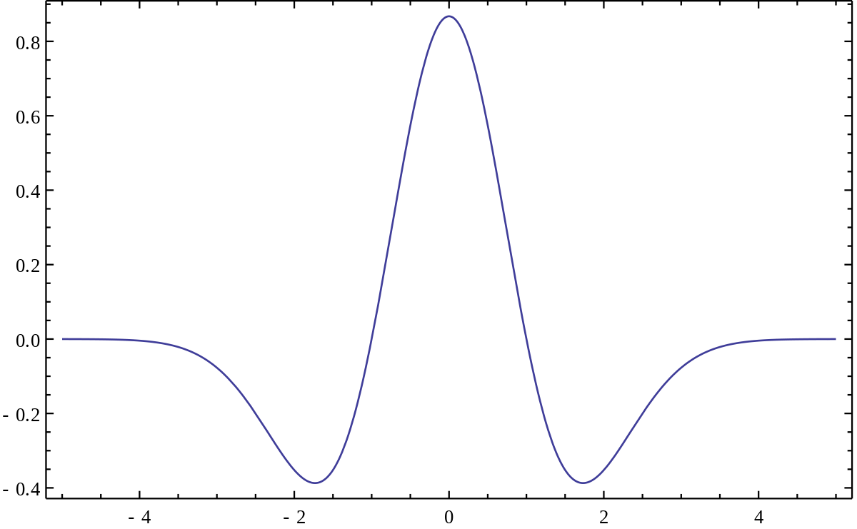
Peak Detection II
The Ricker Wavelet is often chosen to be the mother wavelet for Raman spectra

